Slide 1
Revenue is flat, so where can we grow or lose most?
1 BUSINESS PROBLEM
Revenue grew only 4.6% in 2025 after dipping 0.9% in 2024. Before investing, we asked three questions:
1
2
3
Which products and customers drive the money?
What makes customers unhappy?
Are our discounts earning their cost?
Notes:
Opportunity: protect what drives revenue and fix what drags satisfaction.

Slide 2
50,000 orders, checked and then compared group by group
2 DATA AND METHOD
50K
$32.1M
0
orders from 6 countries, 5 product categories
total revenue, Jan 2023 to Jun 2026
missing values, duplicates or revenue errors after checks
How: we compared results by product, season, age group, delivery speed and discount level, and built an interactive dashboard to explore them.
Caution: customer IDs were not consistent (the same ID showed different ages), so we studied orders, not individual customers.
Notes:
Cleaning checks: no nulls, no duplicate IDs, every order total reconciled with price x quantity x discount. 648 unusually large orders were flagged and tested; conclusions did not change without them.

Slide 3
Four things management should know
3 KEY FINDINGS
77%
44%
of revenue comes from Electronics, but only 30% of orders
of each year's revenue arrives in Nov-Dec, just 2 months
1 in 3
$5.3M
orders arrive late (11+ days) and are rated about 2.0 vs 4.0
given away in discounts, 14% of sales before discount
Notes:
Electronics: five products each ~15% of revenue. Peak: Nov-Dec average order is $820 vs $557 the rest of the year.

Slide 4
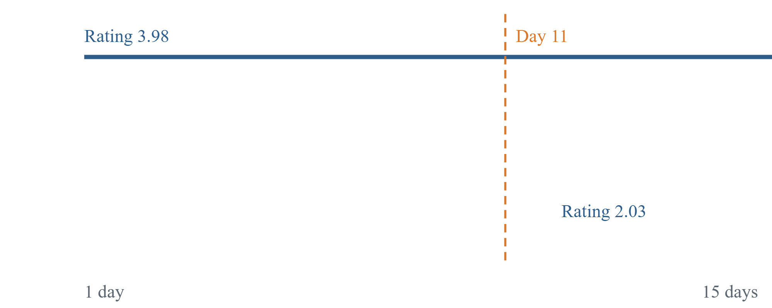
Delivery speed decides the customer rating
4 DEEP DIVE
Day 10 or sooner: average rating 3.98
Day 11 or later: average rating 2.03, and 95% of these orders rated below 3
Everywhere: late rates are 32-34% in all six countries, so this is a company-wide issue, not a local one
Notes:
Rating is flat at about 4 for days 1-10, then drops by half at day 11. 16,656 orders were late.

Slide 5
What management should do
5 RECOMMENDATIONS
1
2
Fix delivery first. Set a 10-day maximum and find why a third of orders miss it.
Protect Electronics (stock, supply) and grow Home & Kitchen and Apparel to reduce dependence.
3
4
Test smaller Nov-Dec discounts. Orders hold 3.5 items at both 15% and 30% off.
Target by age: Electronics offers to 25-34 (41% of revenue), Home & Kitchen to 55+.
Notes:
Peak discounts average 22% vs 7% in the rest of the year, yet quantity per order does not rise with deeper discounts inside either season.

Slide 6
What could improve and how we will know
6 EXPECTED BUSINESS IMPACT
Action | What could improve | How we measure it
Faster delivery | Rating could rise from 3.3 toward 4.0 | Late orders: 33% today, target under 10%
Product mix | Less risk from one category | Electronics share of revenue (77% today)
Smarter discounts | Each 1 point cut saves about $0.37M over the period | Discount % of sales (14% today); units per order
Age targeting | More revenue from top groups | Revenue by age group; order value
Notes:
The $0.37M is simple arithmetic: $5.3M of discount / 14.2 points, over 3.5 years. Rating of 4.0 is the on-time average, an upper bound.

Slide 7
Be cautious, then dig deeper
7 LIMITATIONS AND NEXT STEPS
Be cautious
Analyze next
The rating split at day 11 is unusually clean; confirm how ratings are collected
We have revenue, not profit, so margin impact is unknown
Discount results show patterns, not proven cause
2026 data ends in June
Why orders take 11+ days (carrier, warehouse, route)
Whether late delivery loses repeat customers
Profit by category, including discount cost
A controlled discount test in Nov-Dec
Notes:
Next steps need cost and customer-level data that this dataset does not reliably contain.

